Slide 1
OSI Data Link Layer

Slide 2
Objectives
Explain the role of Data Link layer protocols in data transmission.
Describe how the Data Link layer prepares data for transmission on network media.
Describe the different types of media access control methods.
Identify several common logical network topologies and describe how the logical topology determines the media access control method for that network.
Explain the purpose of encapsulating packets into frames to facilitate media access.
Describe the Layer 2 frame structure and identify generic fields.
Explain the role of key frame header and trailer fields including addressing, QoS, type of protocol and Frame Check Sequence.

Slide 3
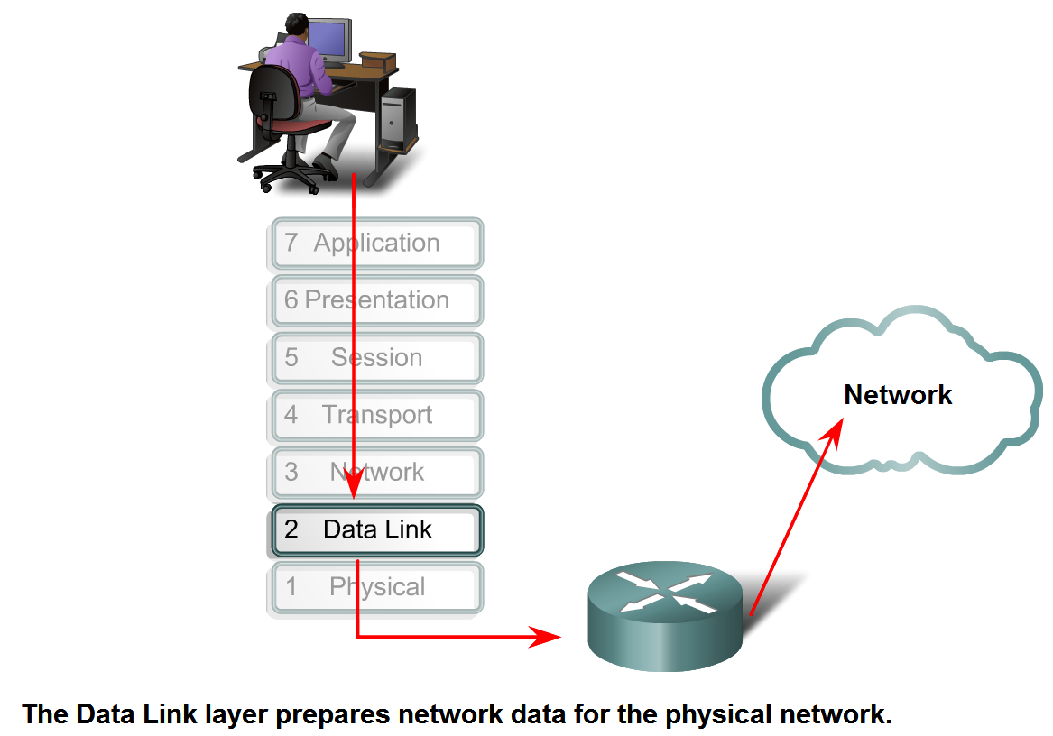
Data Link Layer – Accessing the Media

Slide 4
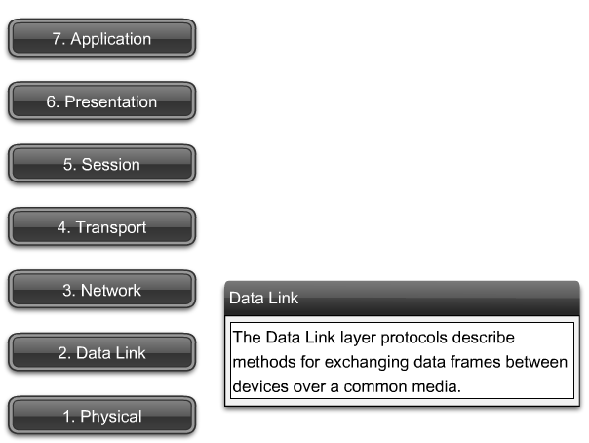
Data Link Layer – Accessing the Media

Slide 5
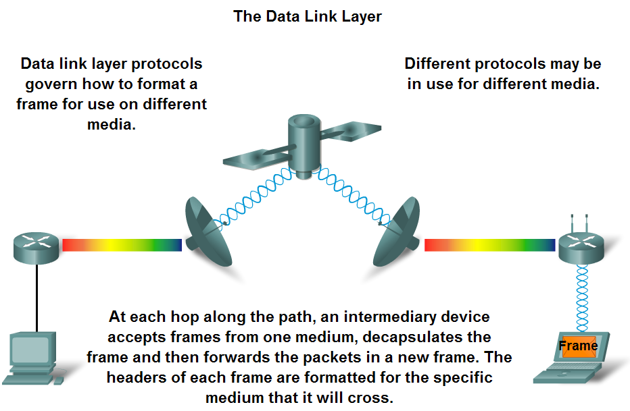
Data Link Layer – Accessing the Media

Slide 6
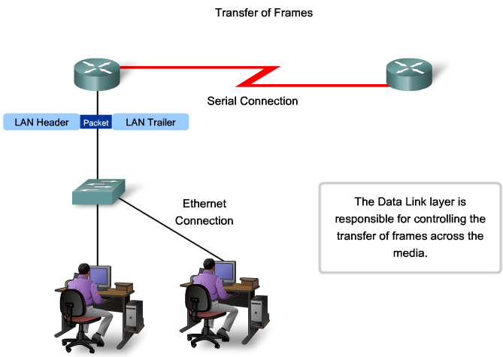
Data Link Layer – Accessing the Media

Slide 7
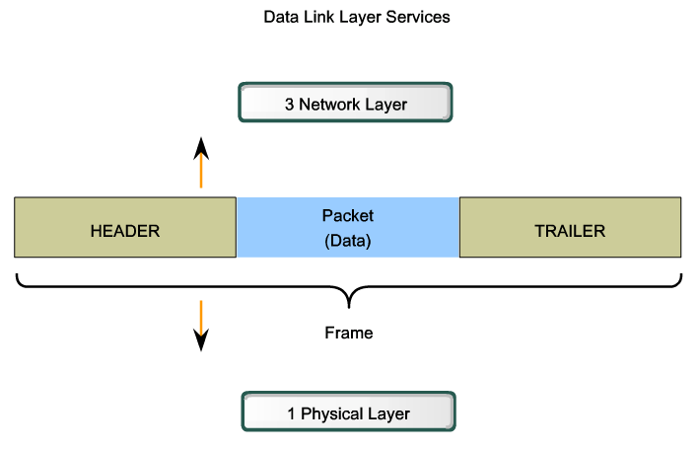
Data Link Layer – Accessing the Media

Slide 8
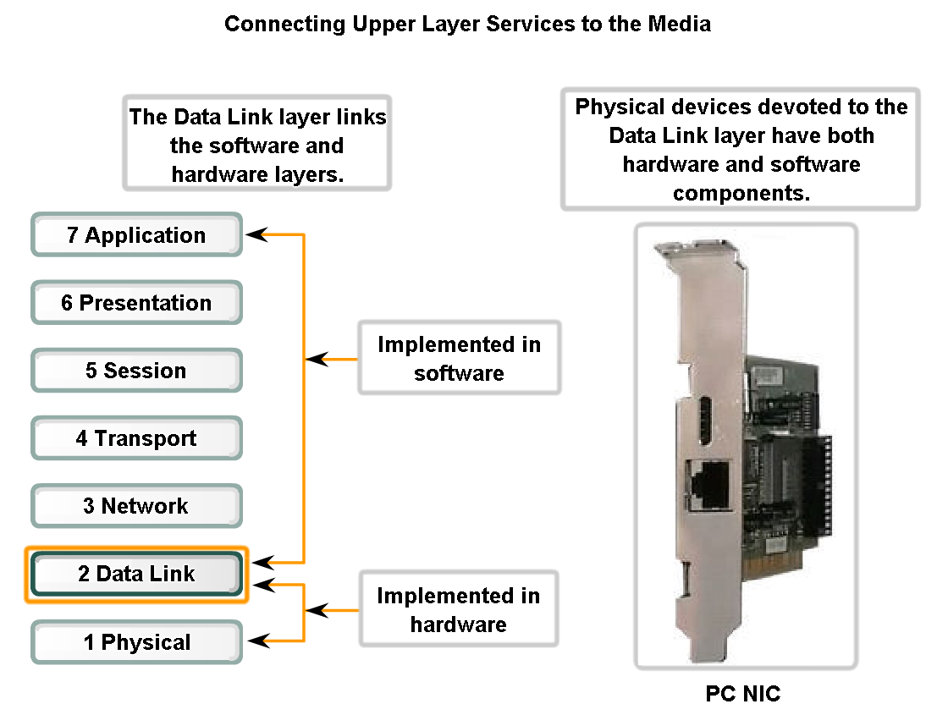
Data Link Layer – Accessing the Media

Slide 9
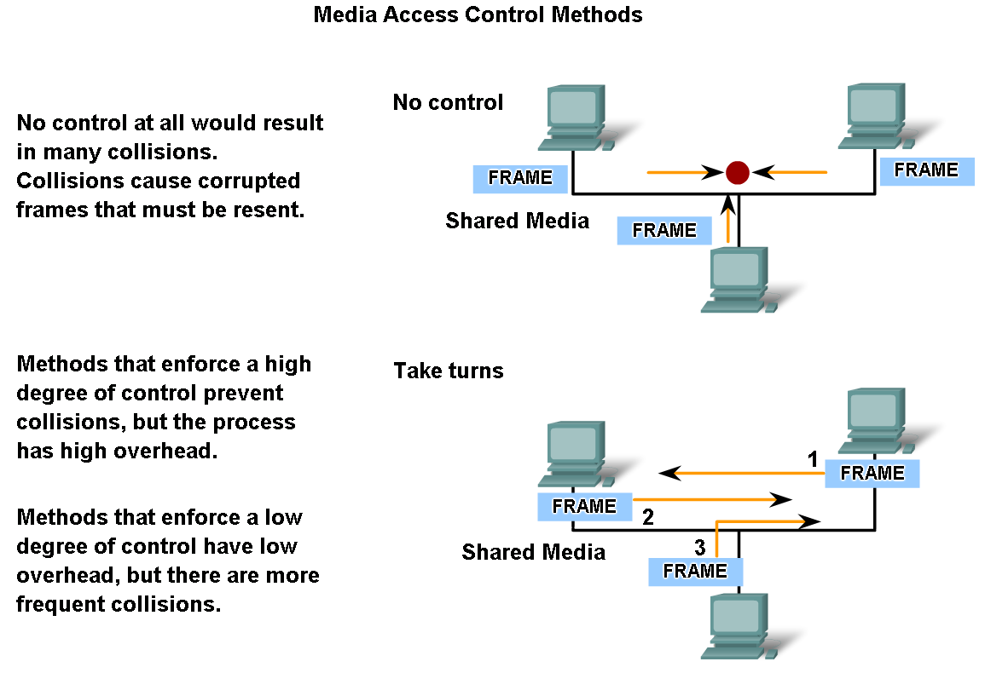
Media Access Control Techniques

Slide 10
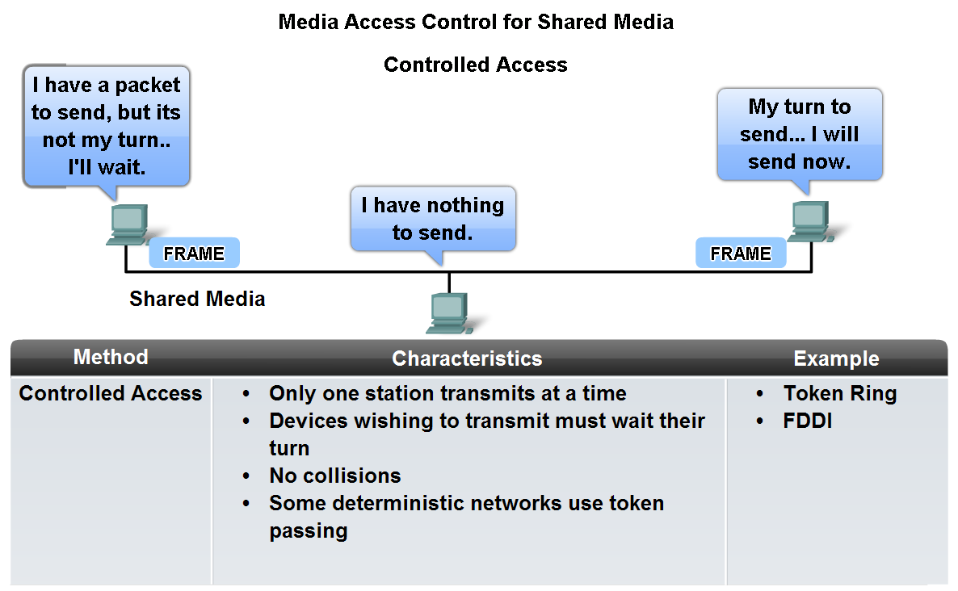
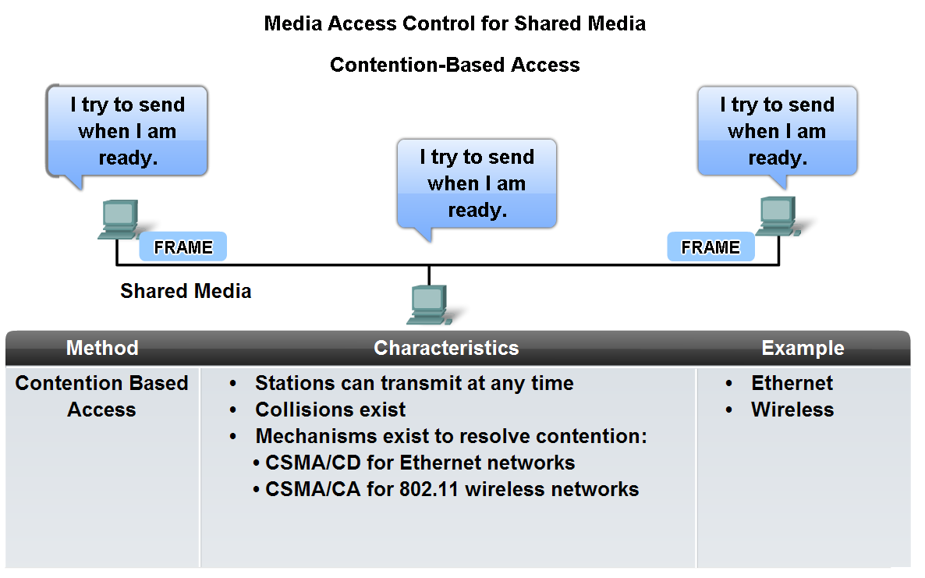
Media Access Control Techniques

Slide 11
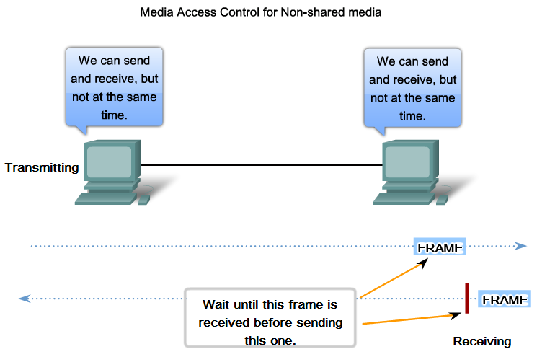
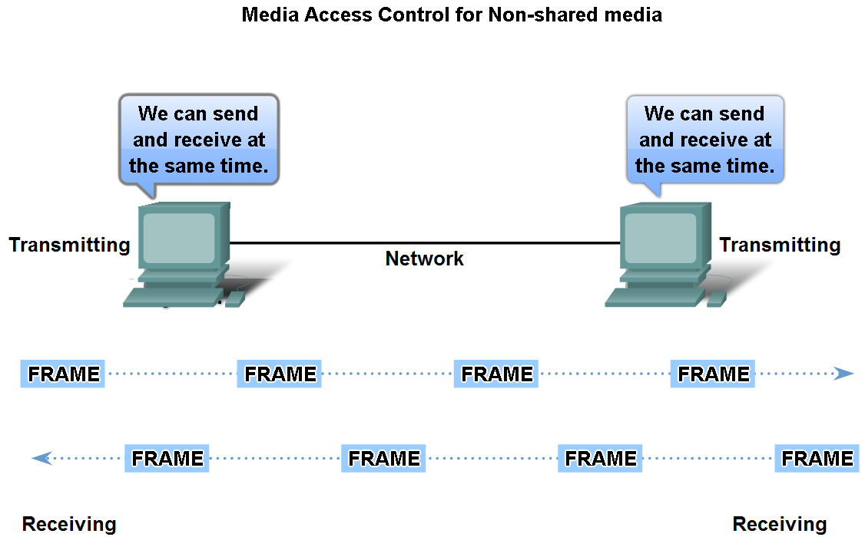
Media Access Control Techniques
Define Full Duplex and Half Duplex as it relates to Media Access Control for non-shared media
Half Duplex
Full Duplex

Slide 12
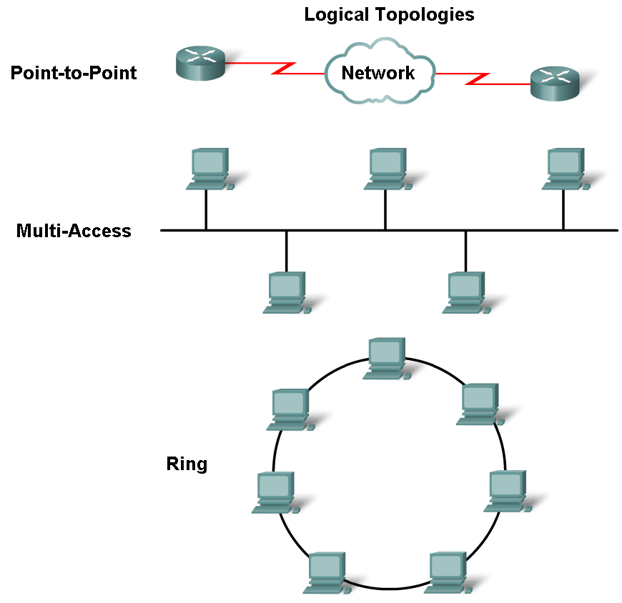
Media Access Control Techniques
Describe the purpose of a logical topology and identify several common logical topologies

Slide 13
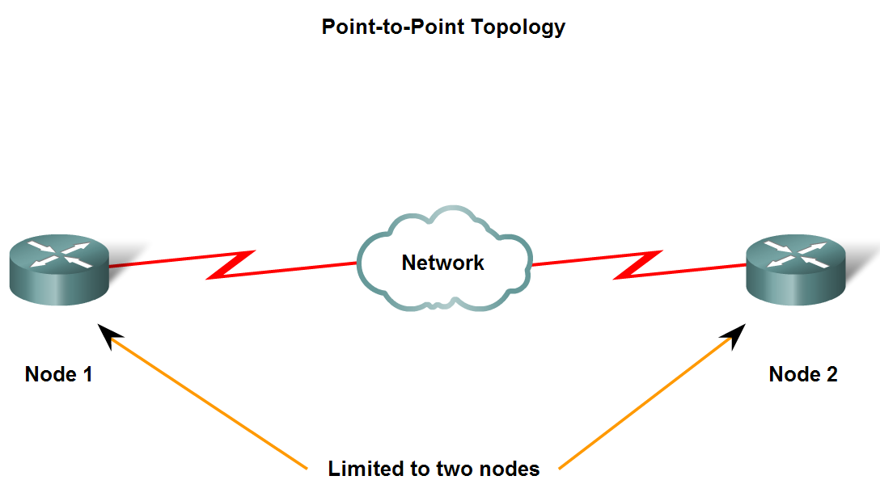
Media Access Control Techniques

Slide 14
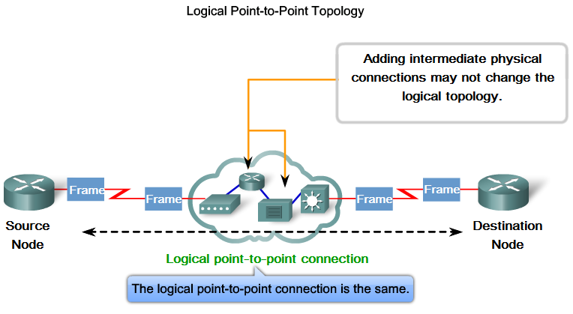
Media Access Control Techniques

Slide 15
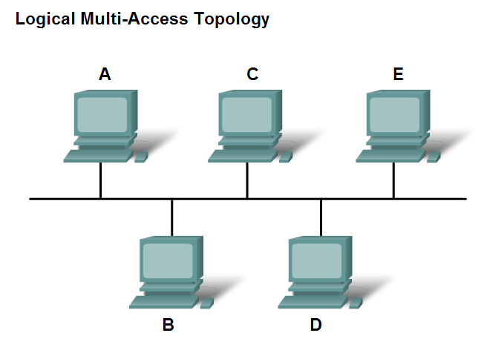
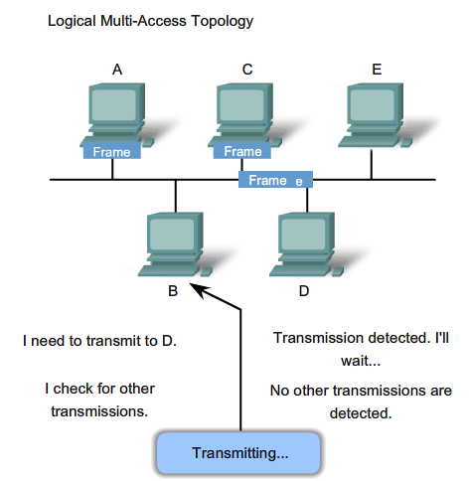
Media Access Control Techniques

Slide 16
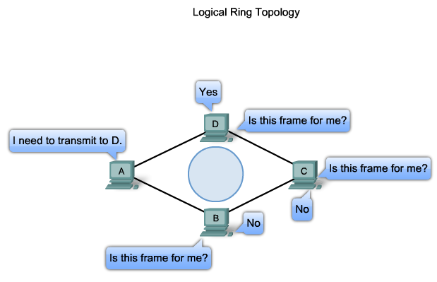
Media Access Control Techniques

Slide 17
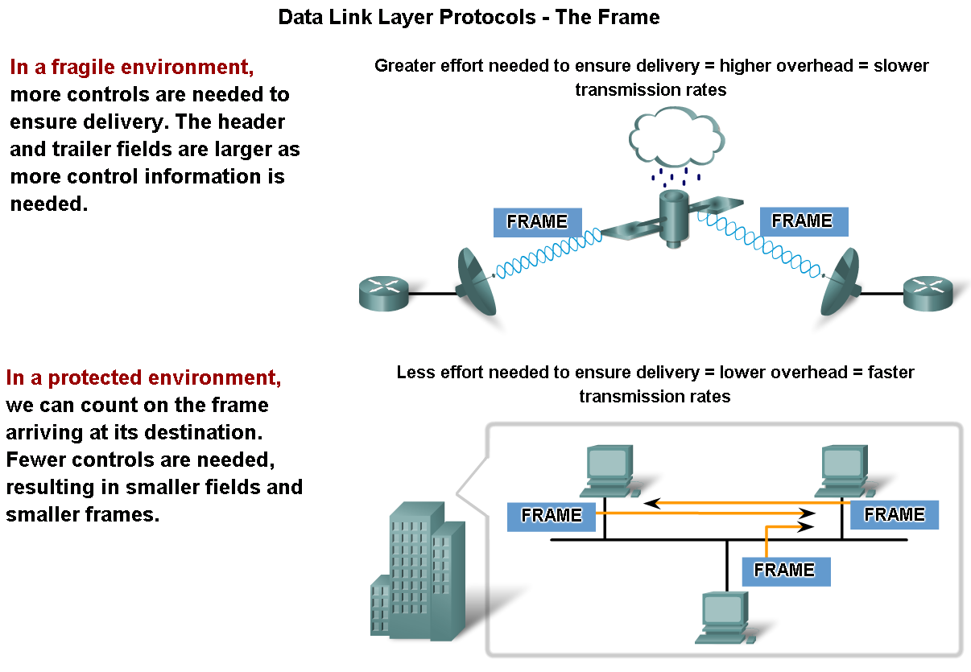
Media Access Control Addressing and Framing Data

Slide 18
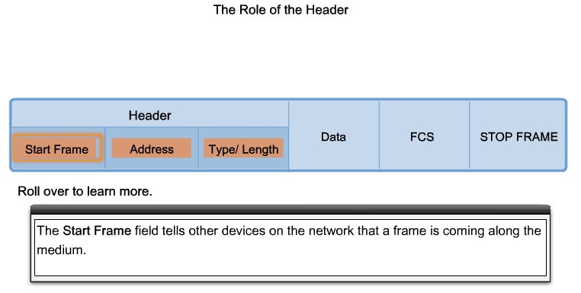
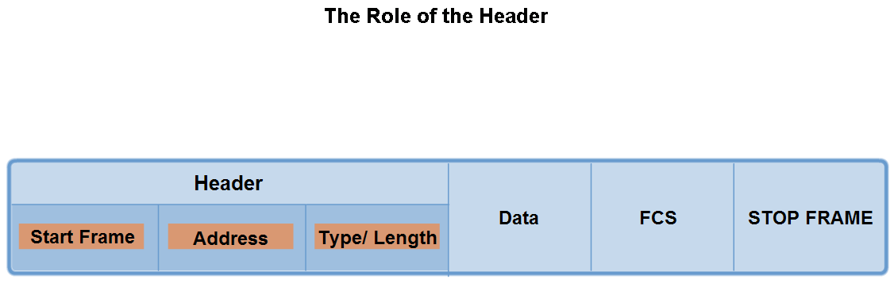
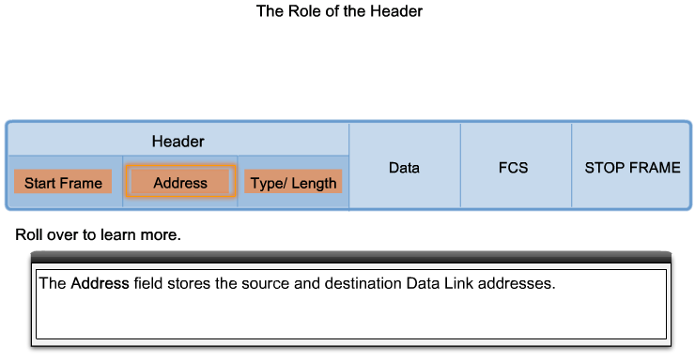
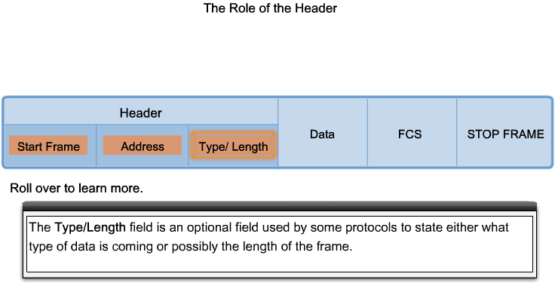
Media access control addressing and framing data

Slide 19
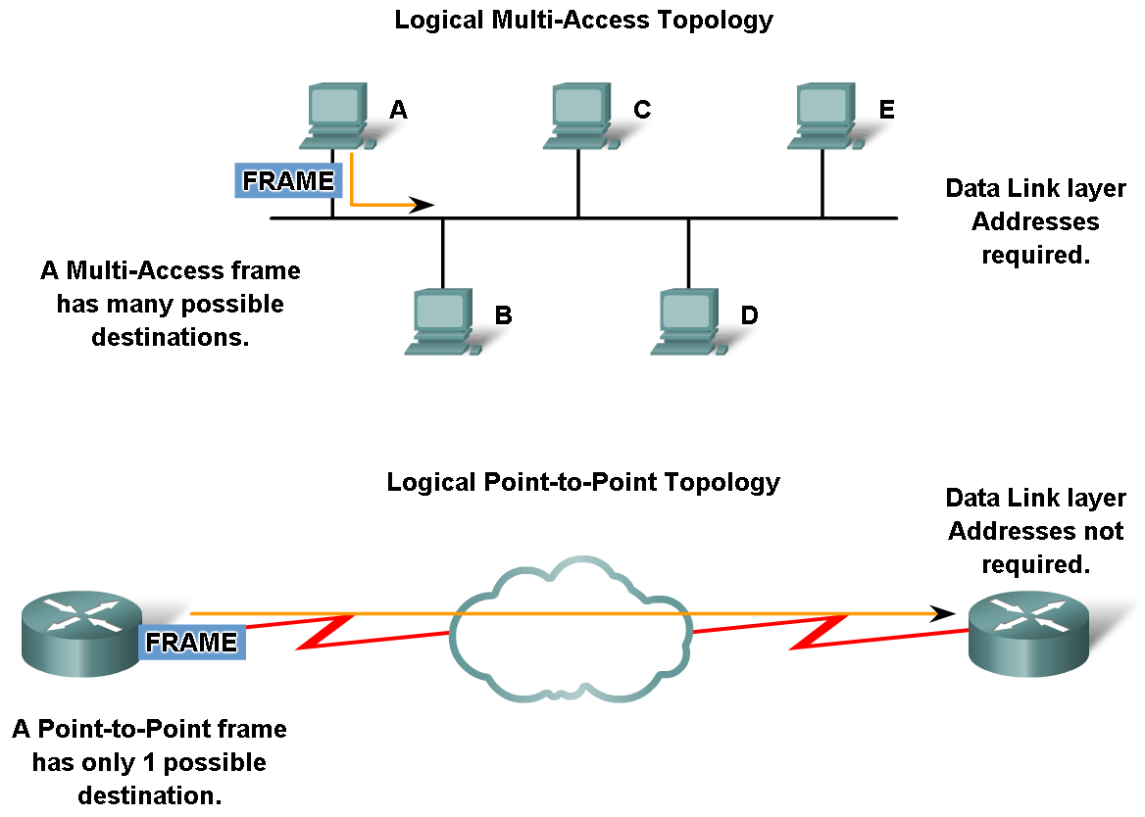
Media access control addressing and framing data

Slide 20
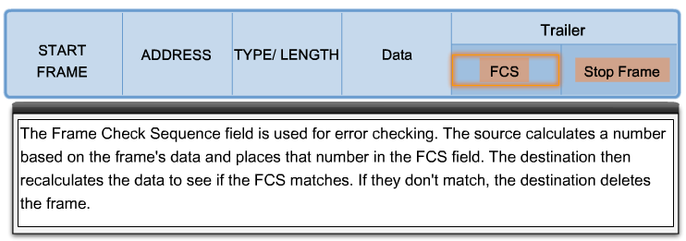
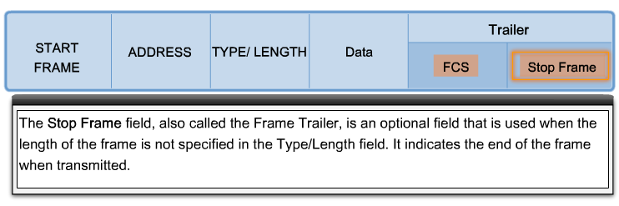
The role of the trailer

Slide 21
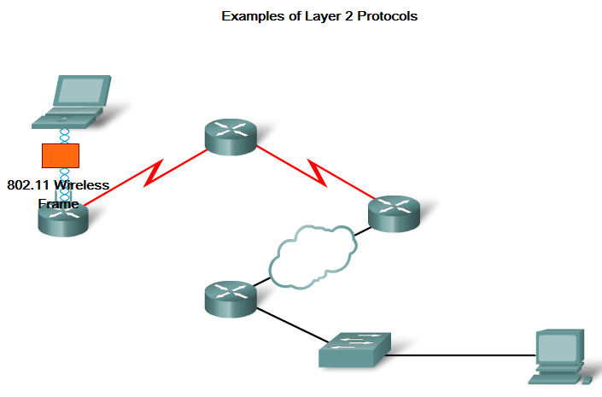
Example of layer two connection

Slide 22
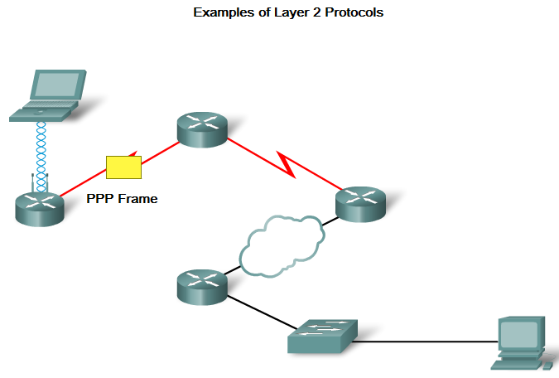
Example of layer two connection

Slide 23
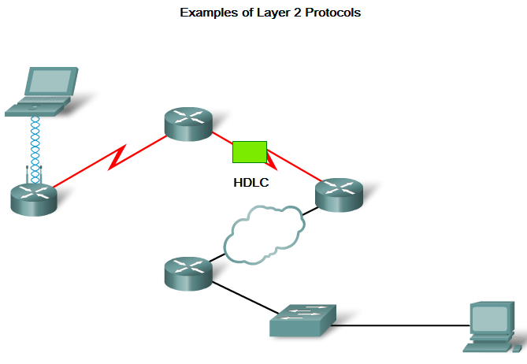
Example of layer two connection

Slide 24
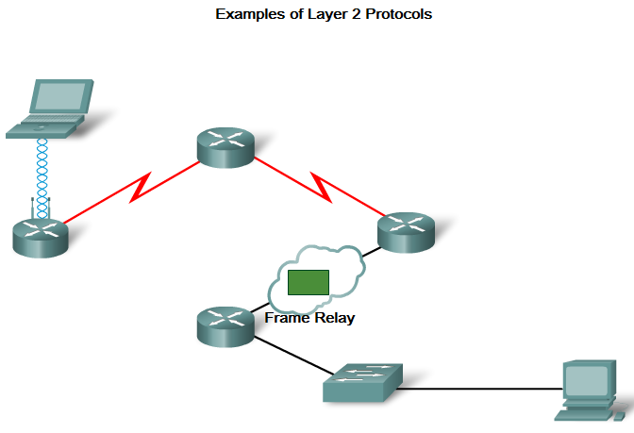
Example of layer two connection

Slide 25
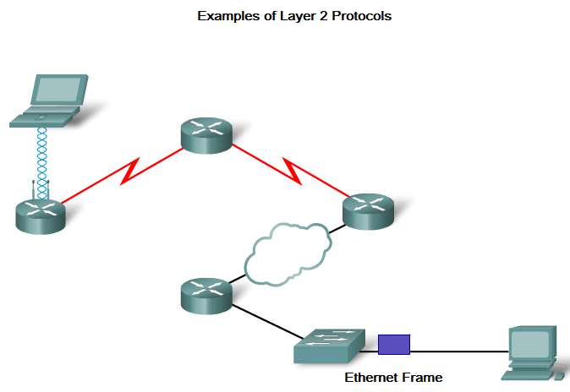
Example of layer two connection

